Slide 1


FAST-Forward Trial
Hypofractionated Breast Radiotherapy for 1 vs 3 weeks: 10-year Updates
from
Mohamad KADRI, MD.
Clinical Oncology

Slide 2
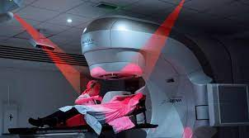
Introduction ..
Radiotherapy plays an important role in the treatment of breast cancer
Modern radiation techniques in terms of positioning, planning and image guidance added higher survival and improved short- and long-term toxicity
Notes:
Descalation of treatment modalities for less extensive resections of breast + regional nodes
Less intensified systemic therapy, gene expression profiling for possible chemo omission
Radiation therapy improves survival in both early and locally advanced breast cancer
In both BCS and PMRT
Resulted in better survival in BCS + RT vs. Mastectomy irrespective of PMRT
For the sake of lecture time my focus will be about adj radiation only

Slide 3

Invasive breast carcinoma - RT
For decades, the standard regimen was 50 Gy in 25 fractions over 5 weeks. This changed after the UK START trials, which demonstrated that 40 Gy in 15 fractions over 3 weeks was equally effective with fewer side effects.
Patients with invasive disease who require adjuvant RT should receive irradiation using hypofractionated 40 - 42.5 Gy in 15-16 fractions over 3 weeks +/- boost.
Rodin et al,. “Standard” Fractionation for Breast Cancer is No Longer Standard. IJROBP 2021
Notes:
SIB 48/15

Slide 4
Breast RT, Is less more?
Breast RT
Breast Cosmesis
Pulmonary Fibrosis
Cardiovascular disease
Psychosocial Impact
Secondary cancer
Musculo-skeletal
With 10 years OS > 80% more focus to improve quality of life for surviving patients
Less extensive resections of breast + regional nodes
Less intensified systemic therapy, gene expression profiling for possible chemo omission

Slide 5
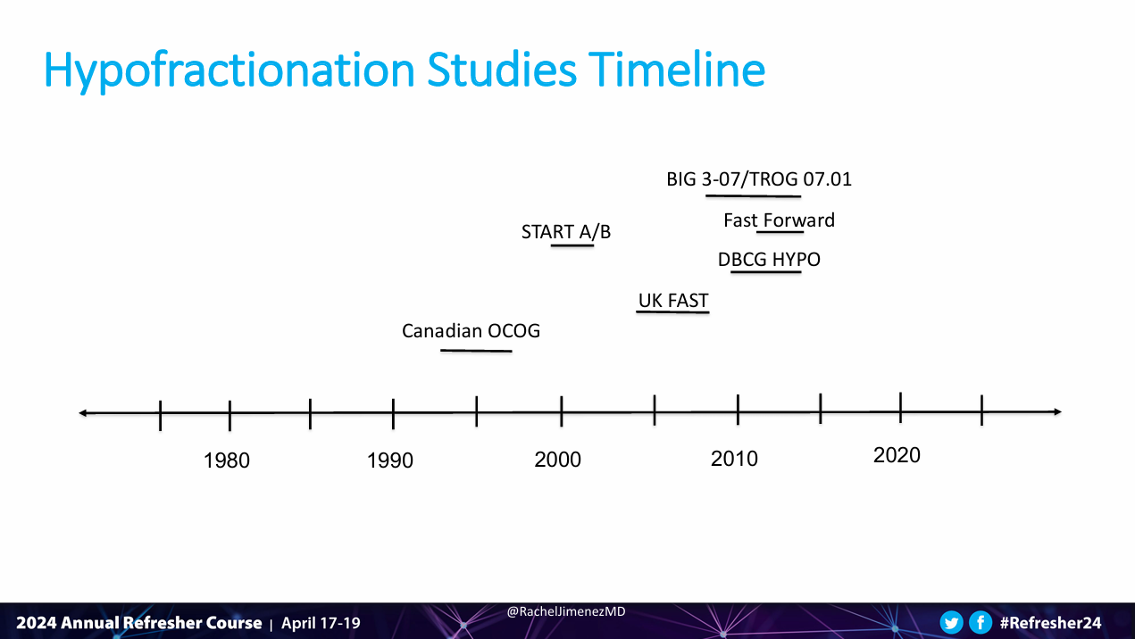

Slide 6
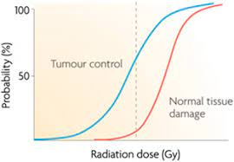
Hypofractionation (less dose, less fractions)
Rodin et al,. “Standard” Fractionation for Breast Cancer is No Longer Standard. IJROBP 2021
Notes:
Giving the difference of low AB ratio between primary disease and OAR. The use of Hypofx would widen the gap between tumor control and NTD probability resulting in higher therapeutic index

Slide 7
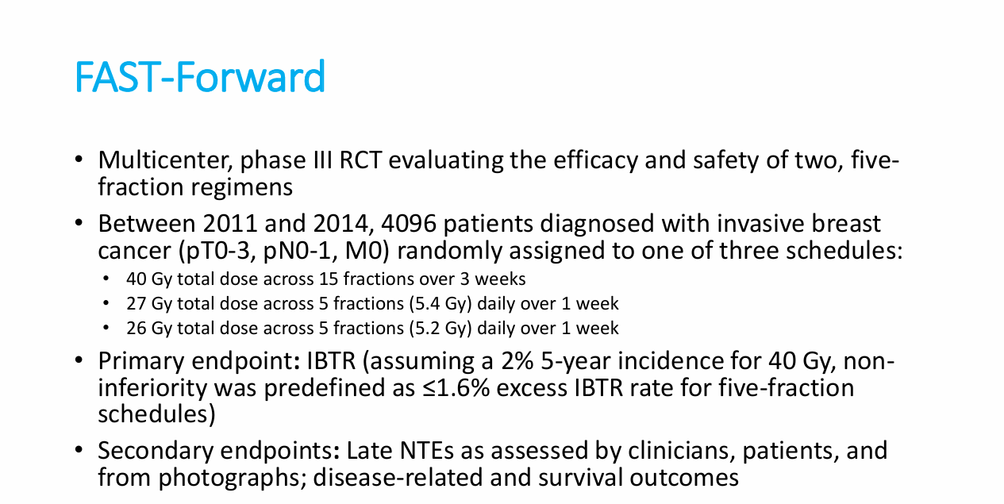
The 27 Gy/5Fr group closed early due to three-year main trial normal tissue effects suggesting 26 Gy/5Fr would be optimal
Boosts were delivered sequentially at doses of 10 Gy/5Fr or 16 Gy/8Fr - Simultaneous integrated boosts were not permitted.
IBTR= ipsilateral breast tumour relapse – NTEs = Normal tissue effects were assessed by clinicians, patients, and from photographs.

Slide 8
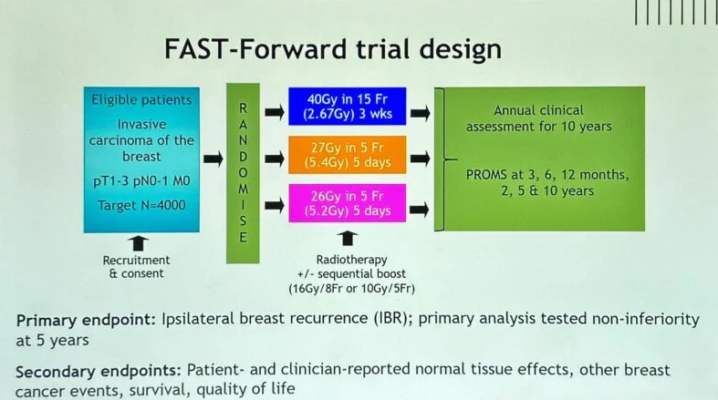
Between April 2016 and October 2018, 469 patients were recruited into the FAST-Forward : 182 in 40 Gy/15Fr, 183 in 26 Gy/5Fr and 104 in 27 Gy/5Fr , 309 patients were randomised prior to the closure of the 27 Gy/5Fr group in December 2017; The 27 Gy/5Fr group closed early due to three-year main trial normal tissue effects suggesting 26 Gy/5Fr would be optimal

Slide 9
Ultrahypofractionation Considerations
The whole breast CTV, including the soft tissues from 5 mm below the skin surface to the deep fascia, Post-mastectomy chest wall CTV encompassed post-surgical skin flaps and underlying soft tissues to the deep fascia; both excluded underlying muscle and rib cage.
Atlas-based radiotherapy planning, including quality assurance.
The PTV margins were 5–10 mm as appropriate.
Beam energies for treatment were 6 MV or 10 MV, but a mixture of energies—eg, 6 MV and 10–15 MV—was allowed for larger patients.
Ipsilateral lung V8 Gy <15%
Heart V1.5 Gy <30% and V7 Gy <5%
The max. dose to 0.1 cm3 the brachial plexus should not exceed 105% of the prescribed dose.
Breast PTV105% <5%, PTV107% <2%
Dmax <110%
LN V107% ≤ 2% of LN PTV DVH.

Slide 10
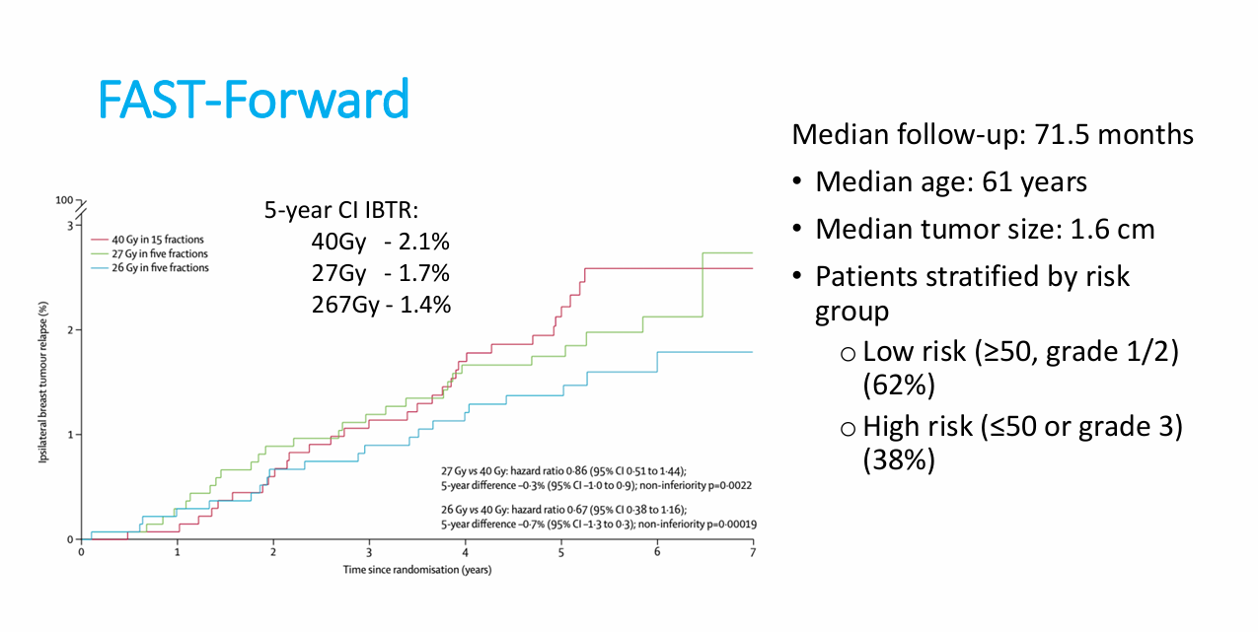
Brunt et al., The Lancet

Slide 11
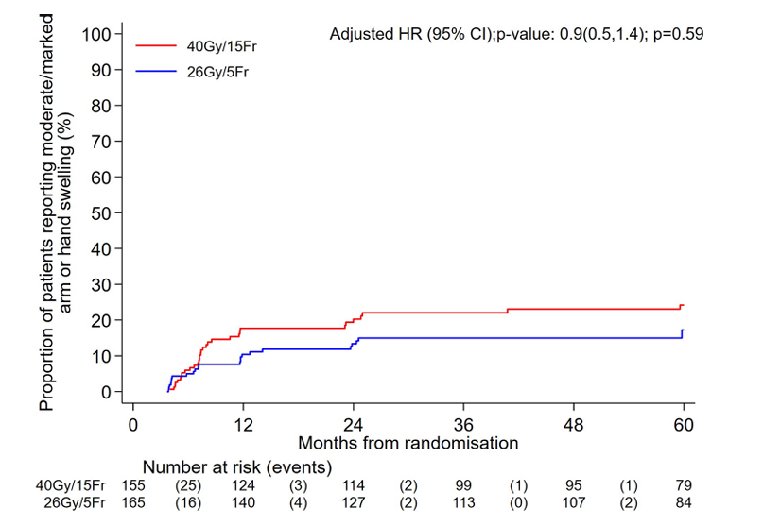
Patient-reported arm or hand swelling up to 5 years

Slide 12
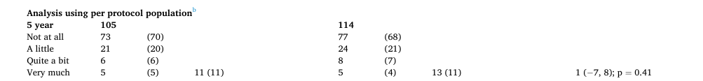
Patient-reported arm or hand swelling up to 5 years
FAST-Forward Trial - Brunt et al., The Lancet

Slide 13
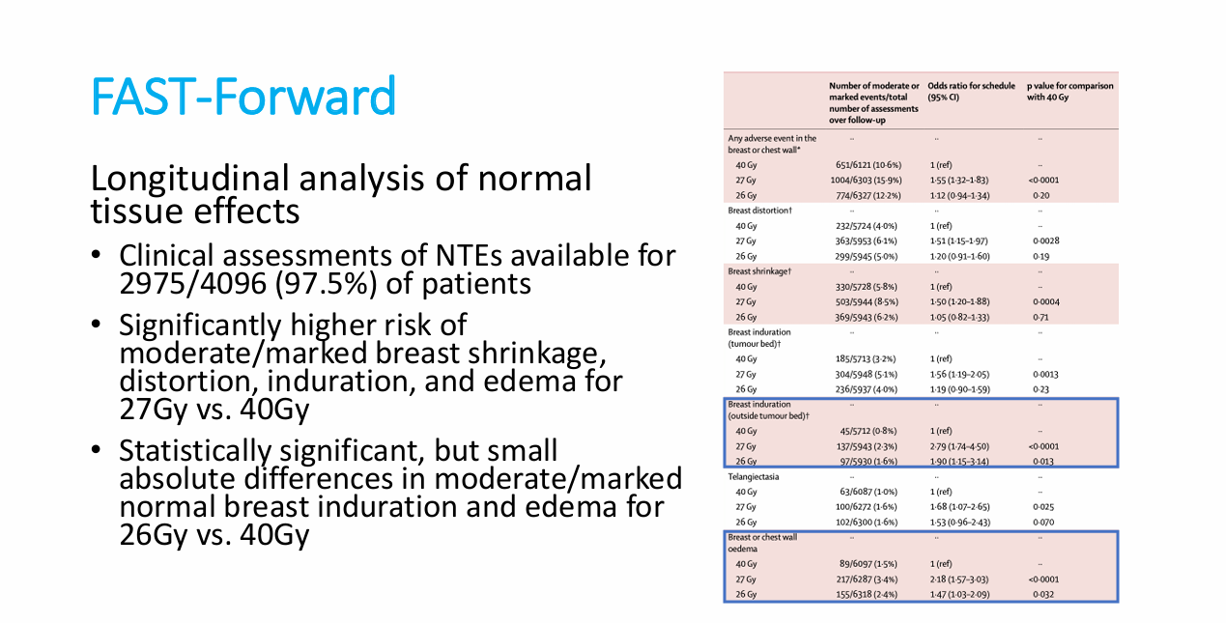
Brunt et al., The Lancet

Slide 14
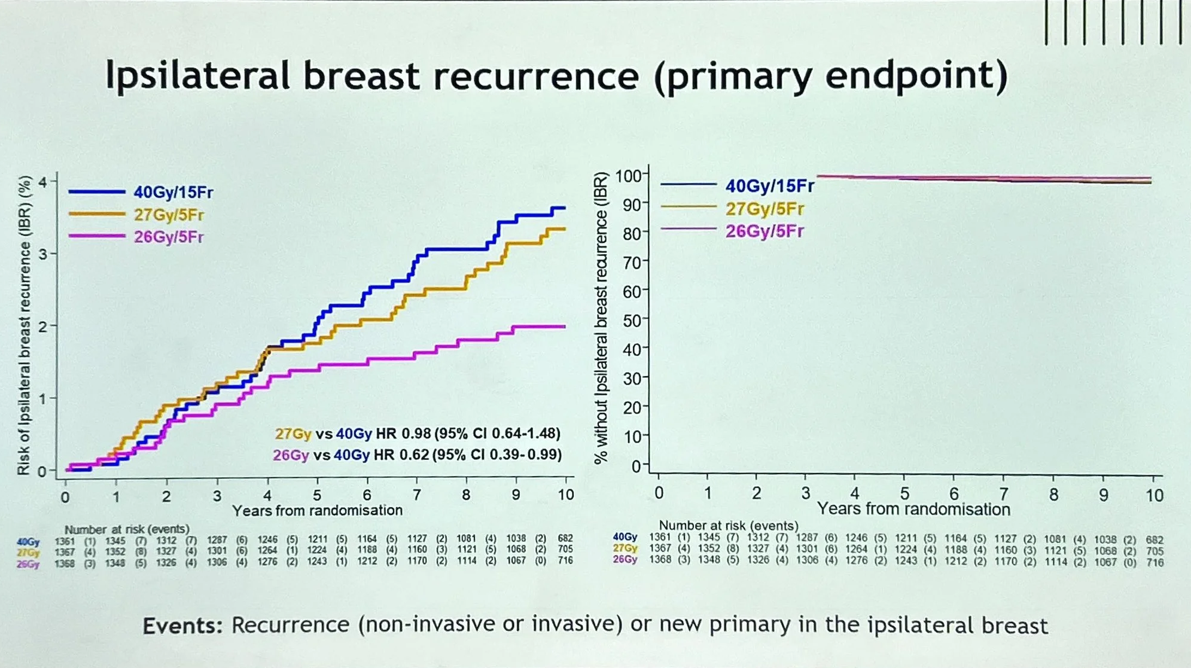

Slide 15
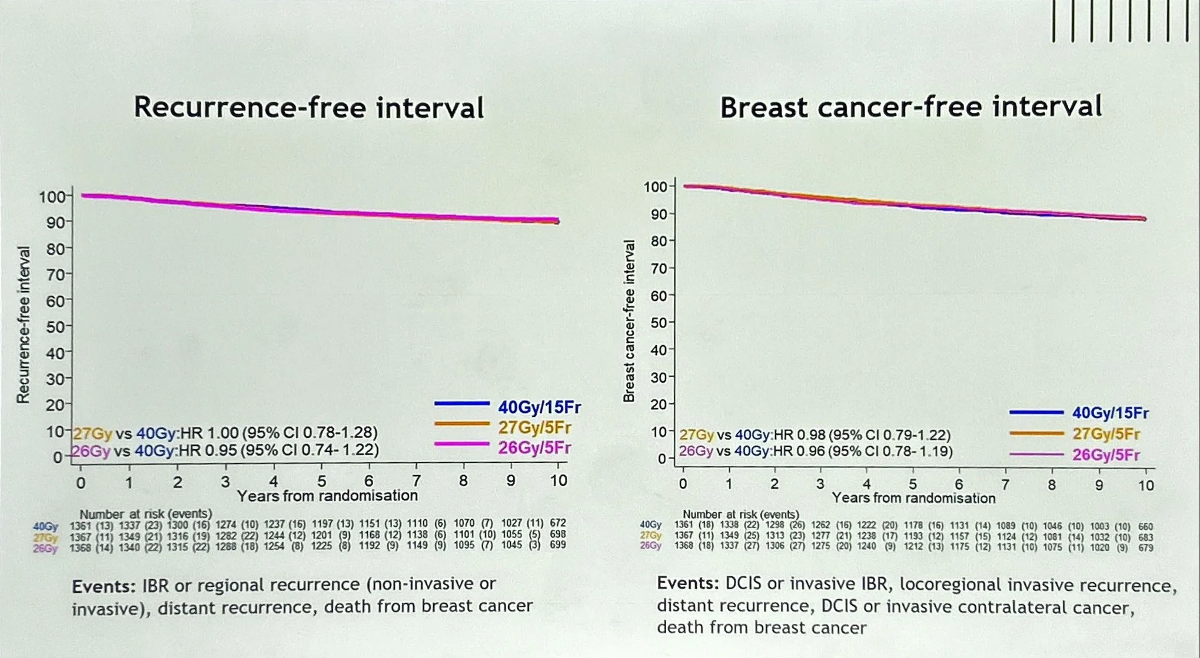

Slide 16
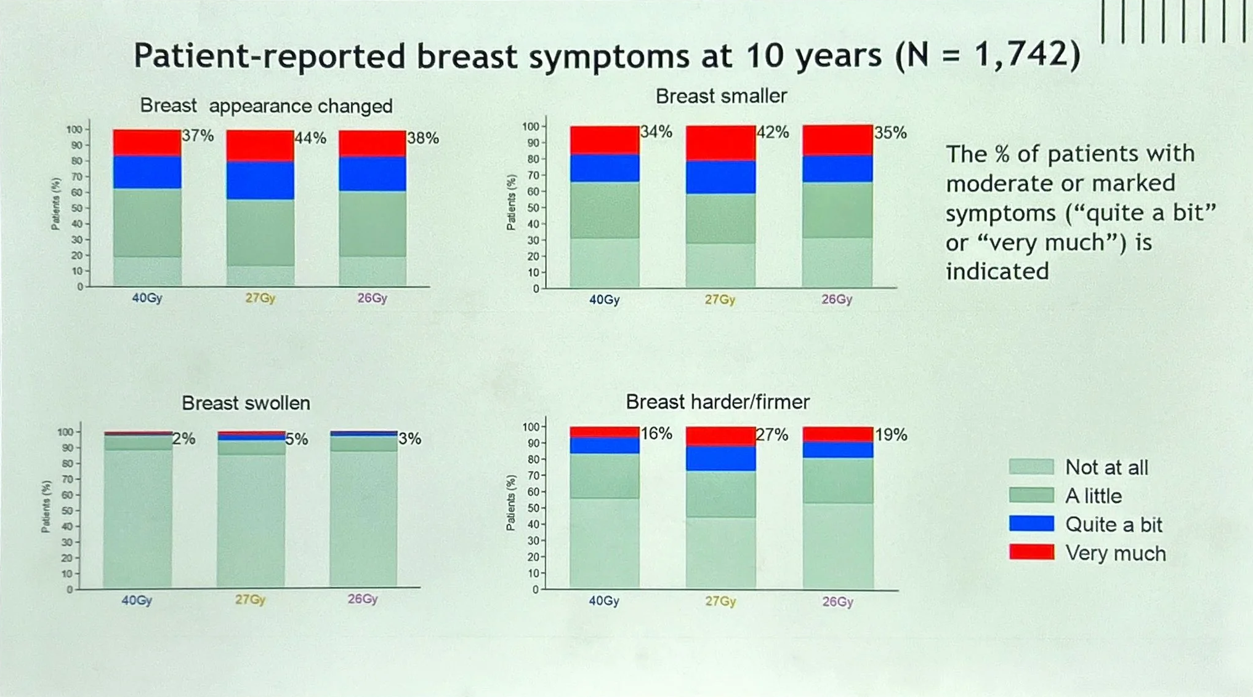
No significant differences in other late adverse effects: Rib fractures, Symptomatic lung fibrosis, and Cardiac ischemia.

Slide 17
Key findings from the 10-year results
Oncologic efficacy: The 1-week, 26 Gy in 5 fractions schedule is non-inferior to the 3-week, 40 Gy in 15 fractions schedule in terms of preventing local recurrence.
Local recurrence: The rate of in-breast tumor recurrence was low and similar across all schedules: 40 Gy (3.6%), and 26 Gy (2%).
Survival: Overall survival and breast cancer-specific survival were comparable across arms.
Normal tissue effects:
  26 Gy vs. 40 Gy: Late effects such as firmness, shrinkage, and induration were similar between these two groups.
  Patient-reported outcomes: Patient-reported symptoms, appearance, and swelling were similar between the 26 Gy and 40 Gy groups.
Nodal radiotherapy: Promising results for hypofractionated nodal irradiation are emerging, but more time is needed to confirm its status as a standard therapy.

Slide 18
Limitations …
Exclusion of patients with T4 and/or N2‑3 disease.
Most patients were more than 49 years old. (Median age was 61 ys)
The majority presented with early-stage disease, HR–positive/HER2-negative tumors (81%), while approximately 10% had HER2-positive and 9% TNBC tumors.
Due to the low event rate, the trial was not sufficiently powered to evaluate recurrence rates within subgroups.

Slide 19
Take Home Massage …
Ultrahypofractionation with 26 Gy in 5 fractions should be considered in pts at a low risk of recurrence with special consideration of
  Elderly and/or frail patients who are not suited to radiotherapy omission;
  Logistical reasons (e.g., long journey, pandemics, capacity limitations);
  Individual patient preferences, personal reasons, and life circumstances.
Ultrahypofractionation should not be applied to patients with an indication for regional nodal irradiation (until publication of the efficacy outcomes of the FAST-Forward nodal sub-study), or to patients with breast reconstruction after mastectomy.

Slide 20
THANK YOU
Mohamad KADRI, MD.
Clinical Oncology
mkadri73@hotmail.com

